Slide 1
Employee Promotion Prediction
PGP-AIML
19th June 2023

Slide 2
Contents / Agenda
Executive Summary
Business Problem Overview and Solution Approach
EDA Results
Data Preprocessing
Model Performance Summary
Appendix

Slide 3
Executive Summary
Actionable insights
Employees who engage in multiple training sessions show a tendency for higher promotion rates, despite the majority undergoing only 1 or 2 sessions. This suggests that increasing training opportunities could be directly beneficial.
Departments like Sales & Marketing, Operations, and Technology not only have higher employee counts but also significant variations in promotion rates, indicating department-specific dynamics in promotion practices.
Employees hired through referrals have a noticeably higher promotion rate (12.1%) compared to other channels, suggesting the effectiveness of the referral system in bringing in potentially high-performing candidates.
Higher previous year ratings (4 and 5) correlate with substantially higher promotion rates, emphasizing the importance of performance evaluations in career progression.

Slide 4
Executive Summary
Recommendation
Develop and implement more comprehensive training programs across all departments to ensure employees receive more than the typical one or two sessions. This should be aimed at both skill enhancement and leadership development to support promotion readiness.
Analyze promotion trends within each department to tailor promotion criteria that reflect the unique needs and roles within these departments. This will help in addressing the disparities in promotion rates and ensure a fairer, more equitable promotion process.
Given the success rate of referrals in leading to promotions, expand the referral program to encourage more employees to participate. Consider offering incentives not just for successful hires but also for diversifying the talent pool in alignment with organizational needs.
Implement structured improvement plans for employees with lower performance ratings. These plans should include targeted training sessions, mentorship programs, and regular review points to help these employees enhance their skills and increase their promotion potential.

Slide 5
Business Problem Overview and Solution Approach
Business Problem Overview
Employee promotions are a pivotal aspect of career advancement, serving as a reward for dedication and loyalty. In JMD Company, the HR team manages promotion decisions based on comprehensive employee data, including performance ratings and other key attributes. However, the complexity and volume of data have historically delayed the decision-making process, making it challenging to efficiently and fairly determine promotion eligibility.
Objective
The primary objective for this project is to streamline the employee promotion cycle by leveraging historical data through predictive modeling. The aim is to develop a machine learning model that accurately predicts employee eligibility for promotion, thereby assisting the HR team in making informed, efficient, and timely decisions.

Slide 6
Business Problem Overview and Solution Approach
Solution approach / methodology
1. Data Collection and Preprocessing:
Data Collection: Utilize the existing dataset which contains detailed records for each employee.
Preprocessing: Clean the data to handle missing values, encode categorical variables, and normalize or standardize numerical inputs where necessary.
2. Exploratory Data Analysis (EDA):
Conduct an in-depth analysis to understand the distribution and relationship of variables related to promotion outcomes.
Identify patterns and insights that can influence the model, such as the impact of departments, training scores, and previous year ratings on promotion chances.

Slide 7
Business Problem Overview and Solution Approach
Solution approach / methodology Cont…
3. Feature Engineering:
Derive new features that might better encapsulate the predictive signals in the data, such as interaction terms between department and ratings or age and length of service.
Preprocessing: Clean the data to handle missing values, encode categorical variables, and normalize or standardize numerical inputs where necessary.
4. Model Development:
Build a predictive model using algorithms suitable for binary classification, such as Bagging, Random Forest, or Gradient Boosting Machines.
Evaluate models based on accuracy, precision, recall, and f1-score metrics to ensure the model's robustness and reliability.

Slide 8
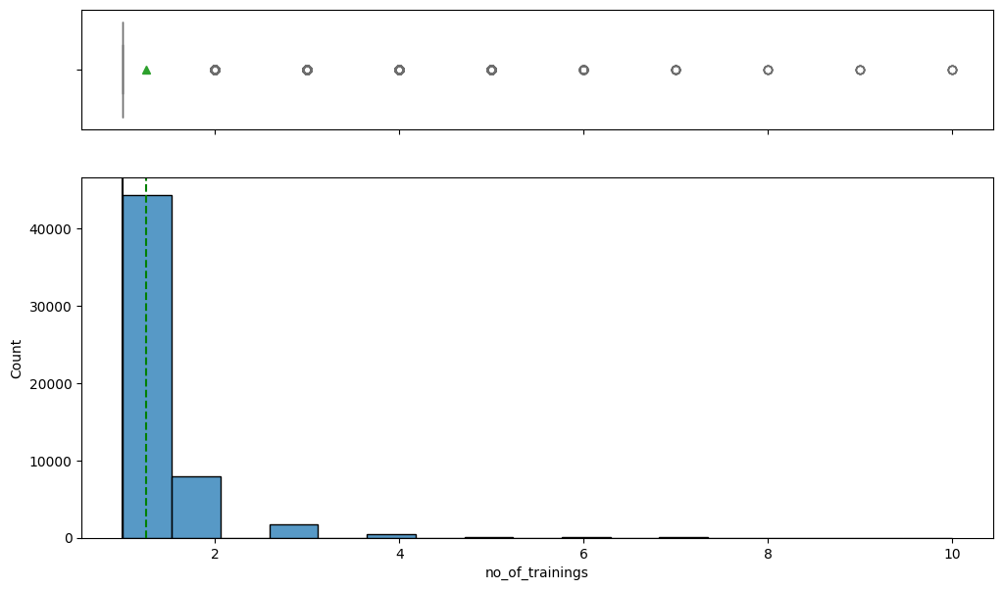
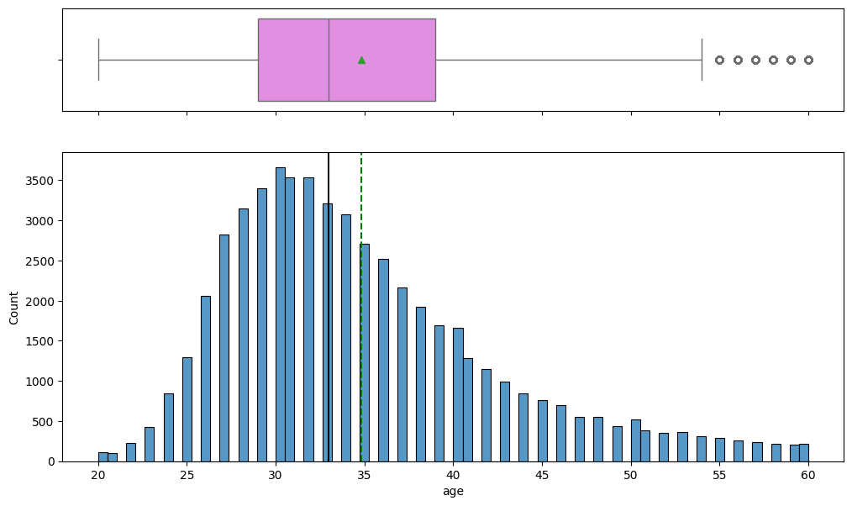
EDA Results
Univariate Analysis
Training Frequency and Intensity
Observation : Most employees undergo only 1 or 2 training sessions, with a significant drop in numbers for more than 2 trainings.
Insight : This suggests a potential underutilization of training programs, despite a small subset engaging in extensive training, which could be better leveraged to enhance overall employee performance and promotion readiness.
Age Distribution
Observation : The age distribution is bell-shaped with most employees between 25 and 40 years old.
Insight : The workforce is relatively young, but with a notable presence of employees over 55, indicating a diverse age range that could impact succession planning and training needs.

Slide 9
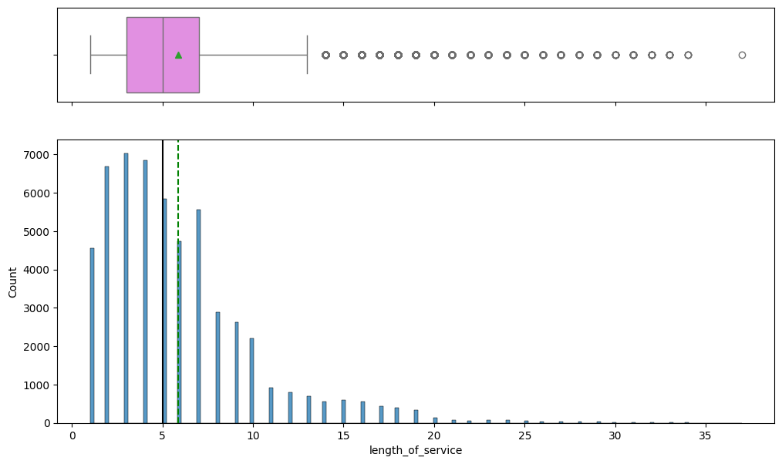
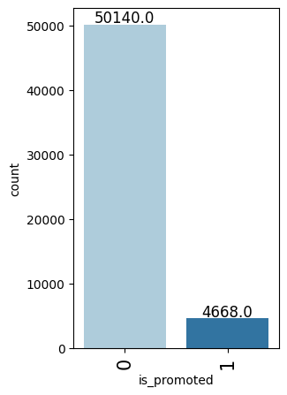
EDA Results
Univariate Analysis
Length of Service
Observation: Employee tenure is right-skewed, most having between 1 to 10 years of service, with outliers showing up to 35 years.
Insight: While a large part of the workforce is relatively new, there exists a segment of highly experienced employees, potentially indicating loyalty or a lack of career progression opportunities.
Promotion Rates
Observation : A stark contrast exists between the large number of employees not promoted versus the few who are, with an overall low promotion rate.
Insight : The competitive or stringent nature of promotions suggests potential morale or retention issues, emphasizing the need for a more transparent or criteria-based promotion system..

Slide 10
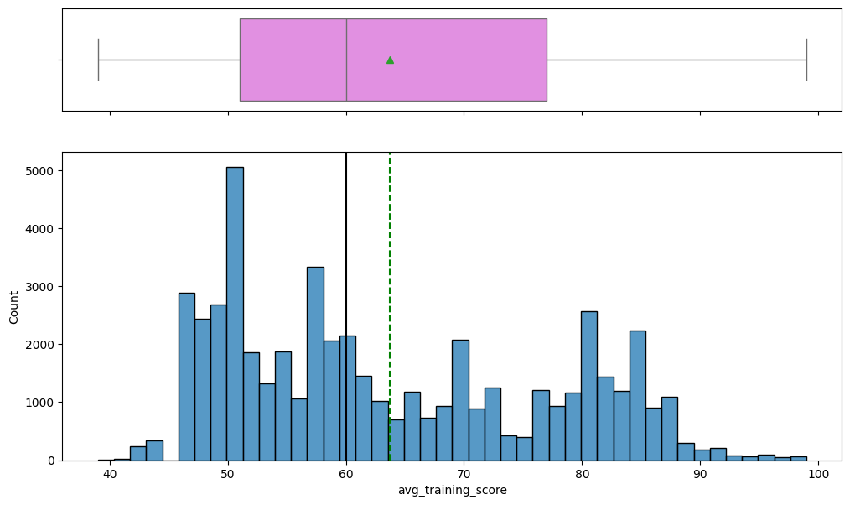
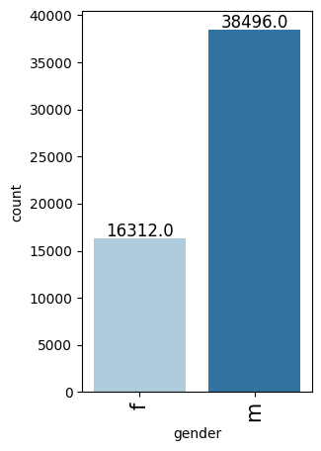
EDA Results
Univariate Analysis
Average Training Score
Observation: Scores show multiple peaks and significant variability, suggesting performance differences across departments or roles
Insight: This diversity in scores could indicate uneven training quality or effectiveness, highlighting a need for targeted improvements in training programs..
Gender Distribution
Observation: The dataset shows a significant gender imbalance, with a much higher number of female employees compared to male employees.
Insight: This pronounced difference in gender distribution might necessitate tailored diversity policies and initiatives to ensure equitable opportunities and promote a balanced workplace culture.

Slide 11
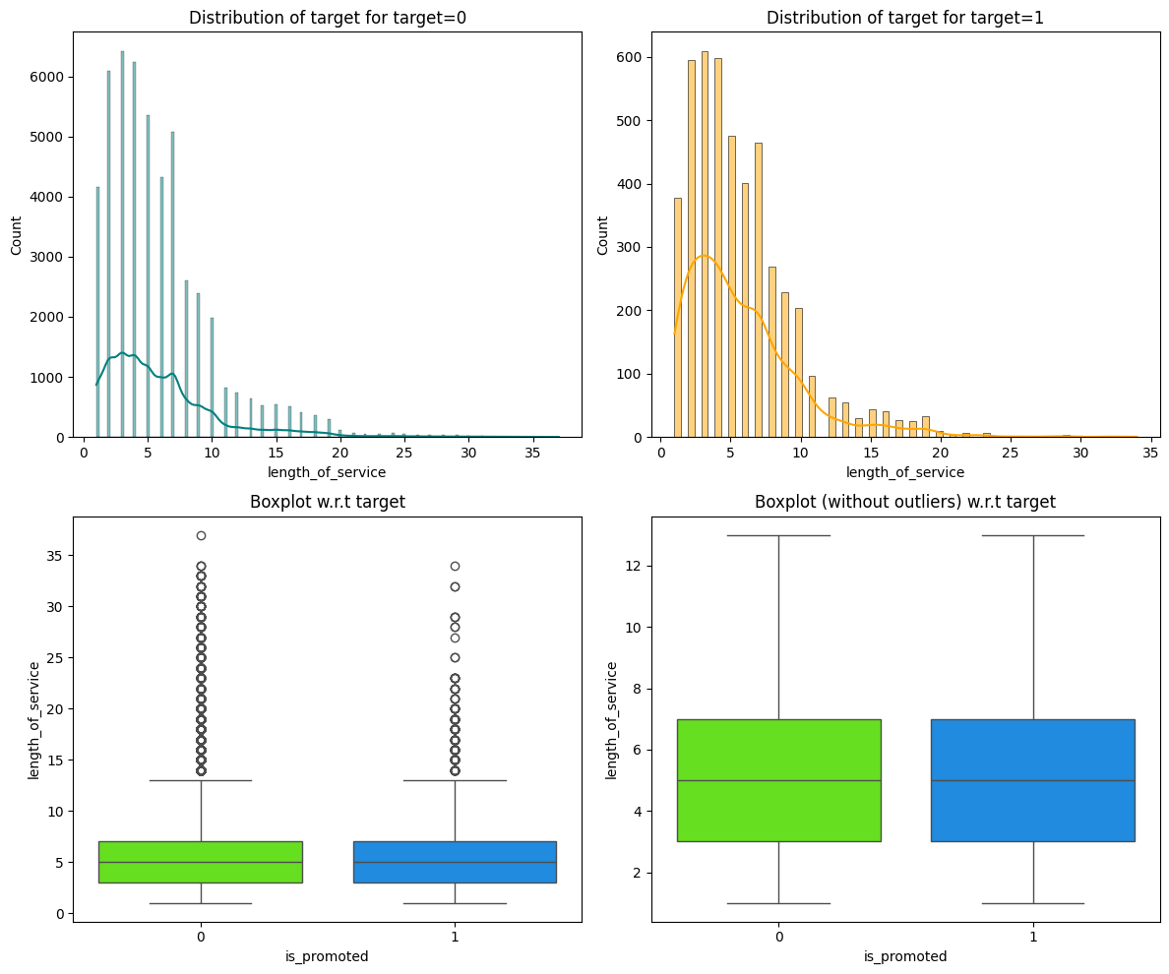
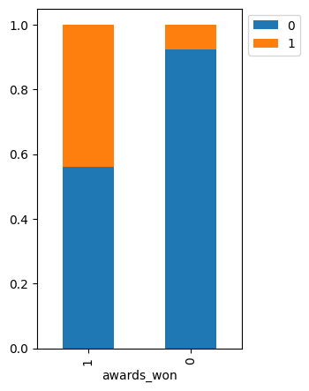
EDA Results
Bivariate Analysis
Length of Service vs. Promotion
Observation: Contrary to expectations, longer tenure does not guarantee promotion; instead, employees with moderate lengths of service (2-10 years) are more likely to be promoted.
Insight: This could suggest that the organization values fresh ideas and potential as much as experience, highlighting the need for career development programs that cater to employees throughout different stages of their tenure.
Awards Won vs. Promotion
Observation: There is a clear distinction showing that employees who have won awards are much more likely to be promoted..
Insight: Recognizing and rewarding outstanding performance can significantly boost promotion rates and might be used effectively as a motivational tool within HR policies.

Slide 12
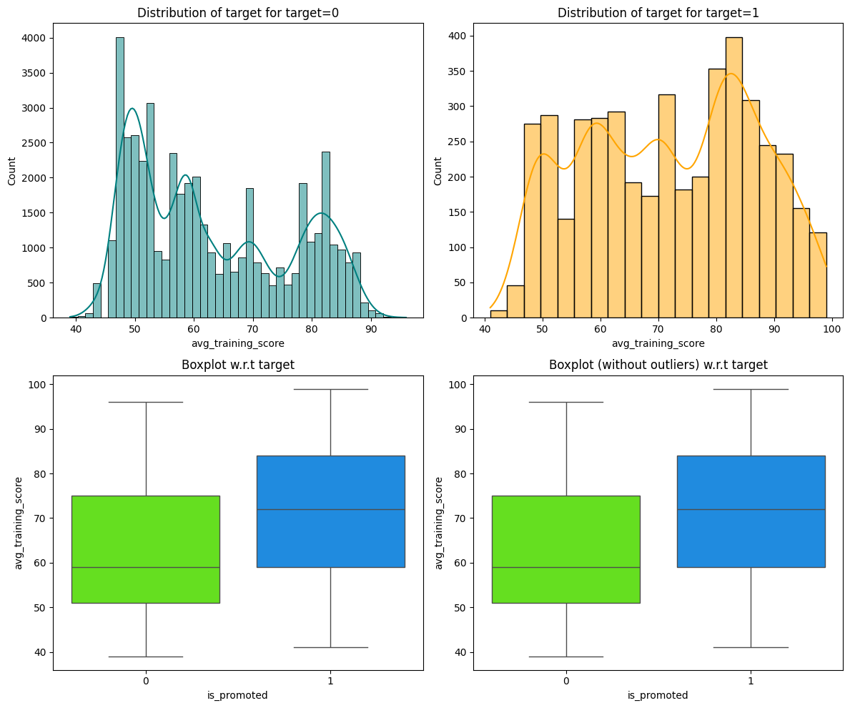
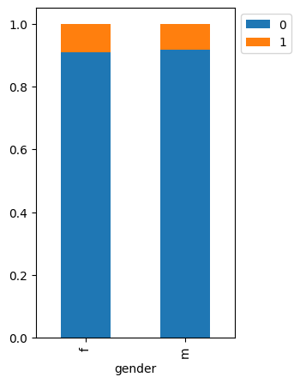
EDA Results
Bivariate Analysis
Average Training Score vs. Promotion
Observation: Higher average training scores are associated with a greater likelihood of promotion, indicating that higher skill and knowledge levels are valued for advancement..
Insight: Investing in employee training that directly enhances job performance can lead to more promotions, supporting a merit-based promotion system..
Gender vs. Promotion
Observation: Female employees have a slightly higher promotion rate compared to male employees, despite there being more male employees overall
Insight: This suggests that gender diversity and inclusivity measures might be impacting promotion practices positively, but continuous monitoring is required to ensure equitable growth opportunities across all demographics.

Slide 13
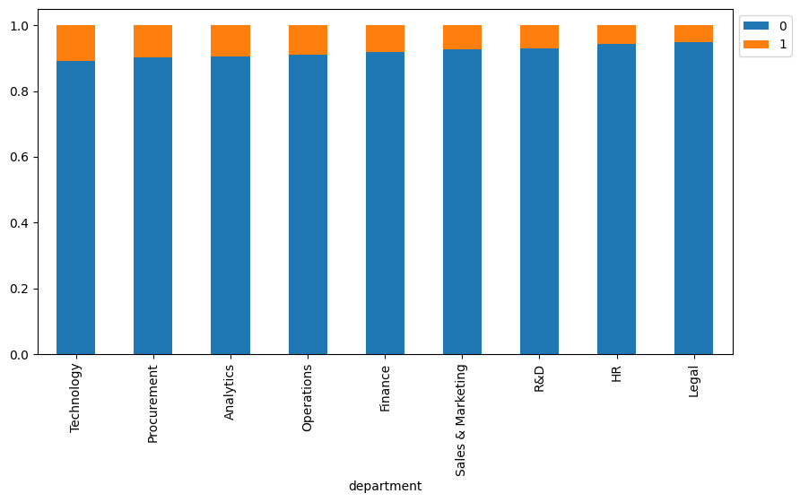
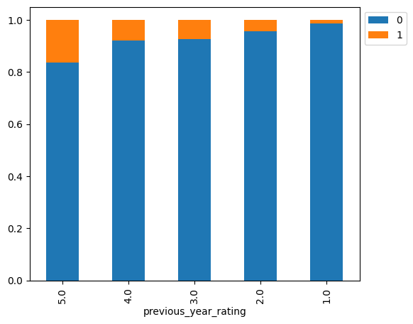
EDA Results
Bivariate Analysis
Department vs. Promotion
Observation: Promotion rates differ markedly across departments, with Sales & Marketing, Operations, and Technology showing higher rates compared to the lower rates in R&D and Legal.
Insight: The variance in promotion rates across departments suggests the need for a standardized or department-specific approach to promotions to ensure fairness and tailored development opportunities.
Previous Year Rating vs. Promotion
Observation: Employees with higher performance ratings (4 and 5) show significantly higher promotion rates compared to those with lower ratings.
Insight: This underscores the importance of performance evaluations in promotional decisions, suggesting that a transparent and fair rating system could directly impact employee motivation and career progression..

Slide 14

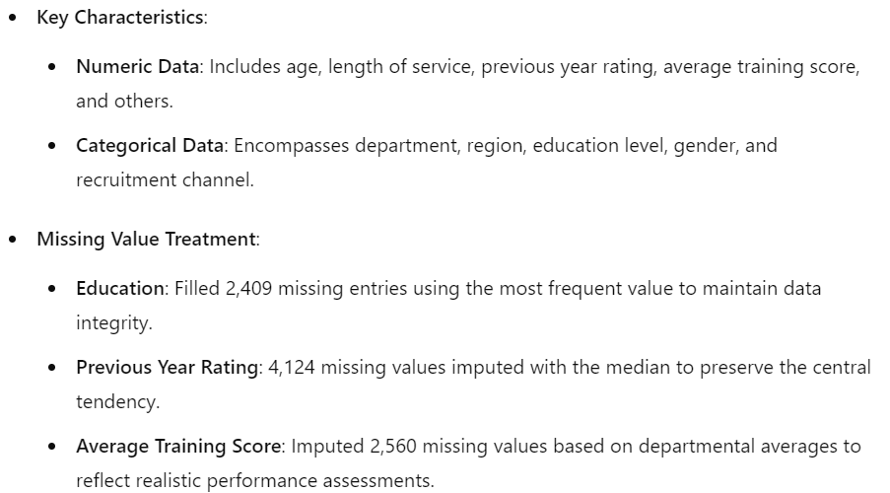
Data Preprocessing

Slide 15
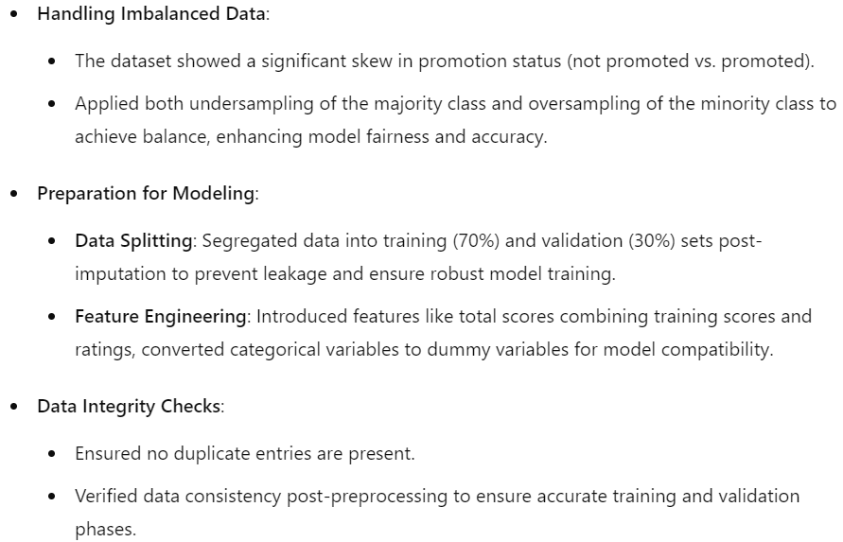
Data Preprocessing

Slide 16
Model Performance Summary
Overview of model and its parameters
Our predictive modeling process leverages a variety of algorithms to address employee promotion predictions based on historical performance data, handling imbalances effectively through strategic data sampling techniques.
Key Model Parameters and Performance:
XGBoost: Utilized for its robustness in handling complex patterns, achieving the highest cross-validation score of 0.9399, reflecting strong generalization capabilities.
Gradient Boosting: Close performance to XGBoost with a score of 0.9367, appreciated for its consistency and less variability in score distribution across different data subsets.
Random Forest and Bagging: Showed competitive performance with scores of 0.9320 and 0.9298 respectively, though Bagging exhibited higher variability which may impact consistency.
AdaBoost: Though it scored the lowest in cross-validation (0.9255), it remains crucial for scenarios requiring iterative correction of errors due to its unique approach in focusing on misclassified instances.
Validation Performance Insights:
Both XGBoost and Bagging excelled in validation settings, indicating their robustness in real-world scenarios with scores tying at 0.3405.
Random Forest and GradientBoosting displayed solid validation performance, underscoring their effectiveness in practical applications.
AdaBoost revealed overfitting tendencies with the lowest validation performance, necessitating further tuning to enhance its practical utility.

Slide 17
Model Performance Summary
Summary of the final model for prediction
Final Model Selection: Gradient Boosting.
Performance Overview
Training Accuracy: 0.941 (Original Data)
Validation Accuracy: 0.940 (Original Data)
Test Set Accuracy: 0.9400
This exceptional consistency across training, validation, and test phases underscores the model's robustness and reliability in predicting promotion outcomes without the necessity for data balancing strategies such as undersampling or oversampling.
Key Performance Metrics on Test Data
Strategic Insights and Model Utility
Precision for 'No Promotion': 0.94
Recall for 'No Promotion': 1.00
F1-Score for 'No Promotion': 0.97
Precision for 'Promotion': 0.91
Recall for 'Promotion': 0.30
F1-Score for 'Promotion': 0.45
The high precision and recall for 'No Promotion' demonstrate the model's effectiveness in correctly identifying non-promotional cases, ensuring minimal false positives.
The lower recall for 'Promotion' highlights a critical area for improvement, suggesting potential enhancements in model sensitivity to detect true promotions more effectively.
Conclusion
Gradient Boosting stands out as the model of choice, excelling in handling the original dataset's complexity and class imbalance with high accuracy. Continuous monitoring and strategic tuning are recommended to maintain its efficacy and adapt to evolving organizational dynamics.

Slide 18
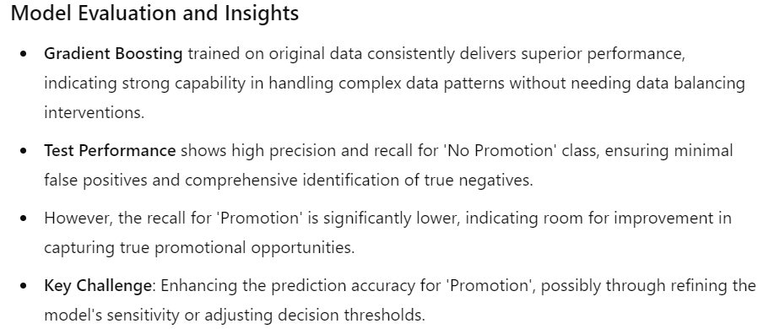
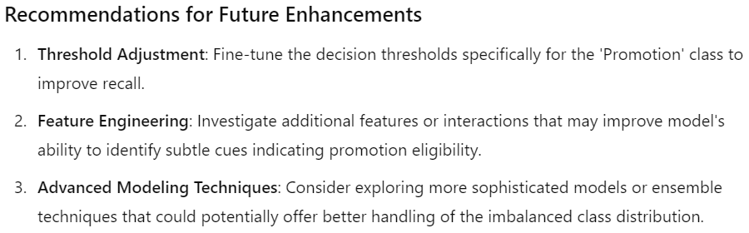
Model Performance Summary
Summary of key performance metrics for training and test data in tabular format for comparison
This presentation summarizes the performance metrics for Gradient Boosting and AdaBoost models across original and undersampled data sets during both training and validation phases. The comparison emphasizes how the models perform on different data preprocessing strategies and provides insights for optimal model selection.
Model | Data Type | Performance on Training Set | Performance on Validation Set | Accuracy on Test Set | Precision | Recall | F1-Score
Gradient Boosting | Original | 0.941 | 0.94 | 0.94 | No Promotion: 0.94 Promotion: 0.91 | No Promotion: 1.00 Promotion: 0.30 | No Promotion: 0.97 Promotion: 0.45
Gradient Boosting | Under sampled | 0.793 | 0.77 | Not Applicable | No Promotion: 0.97 Promotion: 0.23 | No Promotion: 0.77 Promotion: 0.72 | No Promotion: 0.86 Promotion: 0.35
AdaBoost | Original | 0.94 | 0.94 | Not Applicable | No Promotion: 0.94 Promotion: 0.89 | No Promotion: 1.00 Promotion: 0.33 | No Promotion: 0.97 Promotion: 0.48
AdaBoost | Under sampled | 0.712 | 0.831 | Not Applicable | No Promotion: 0.96 Promotion: 0.28 | No Promotion: 0.85 Promotion: 0.62 | No Promotion: 0.90 Promotion: 0.38

Slide 19
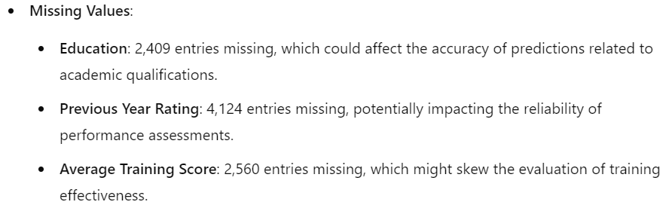
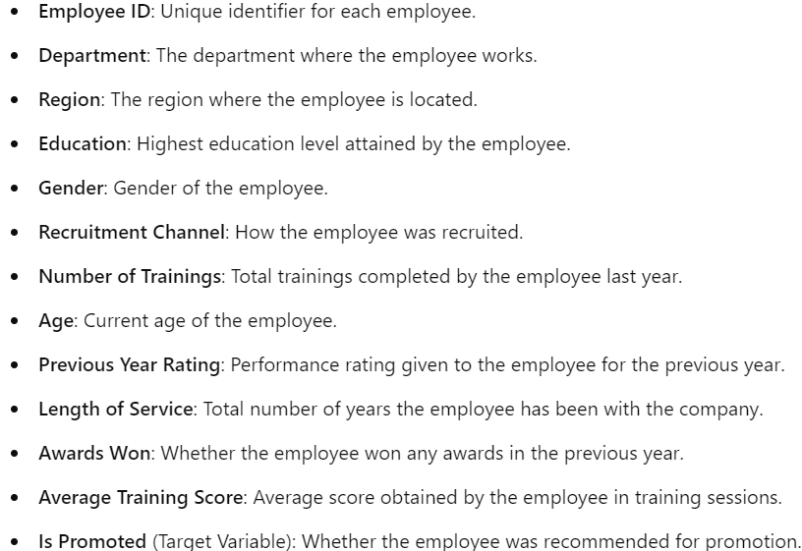
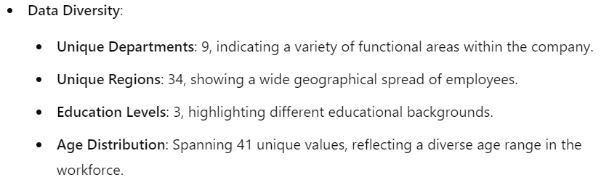
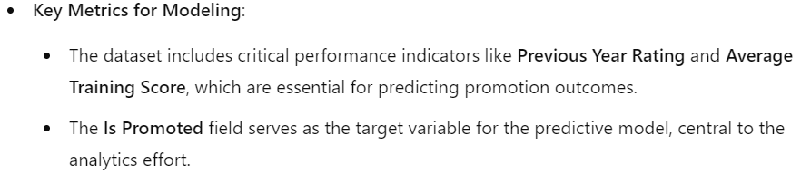
Data Background and Contents
Please mention about the data background and contents
Data Description
Data Challenges and Preprocessing Insights
The dataset encompasses a comprehensive record of all employees who were considered for promotion in the previous year, including whether they were promoted or not. Here’s a breakdown of the data attributes

